Slide 1
Traditional collaborative filtering VS LLM enhanced recommendation
BIT-BDA
Reporter：兰天丞 时间：2025/10/23

Slide 2
目录 | CONTENTS
1
Introduction
2
Traditional CF
3
CF workflow
4
Challenges and solution
5
Arise of LLM

Slide 3
目录 | CONTENTS
6
LLM4Rec
7
LLM＋CF
8
CF vs LLM
9
NEW Trend

Slide 4
1
Introduction

Slide 5
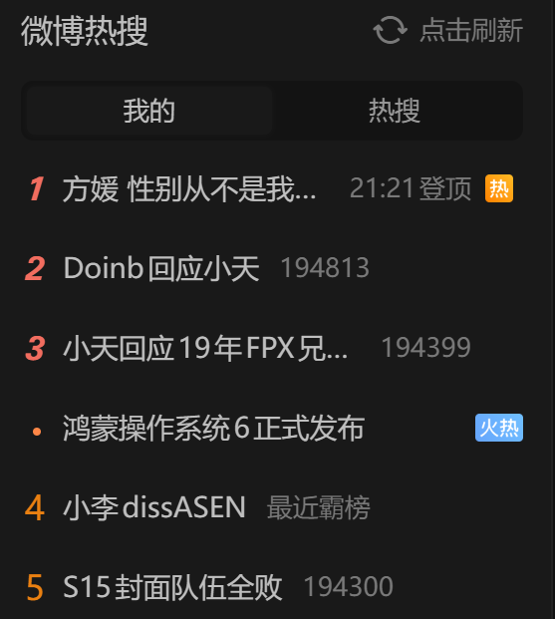
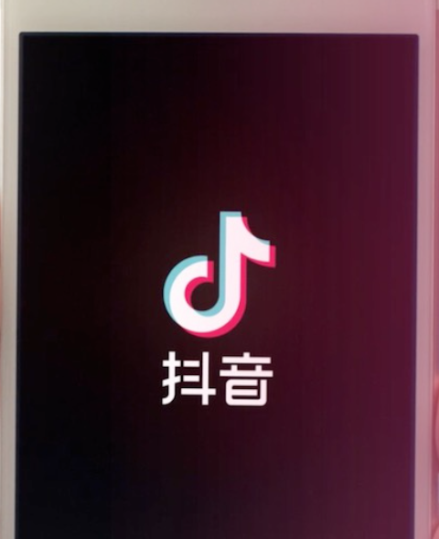

What is Recommendation System?
A recommender system is a type of system designed to predict items (such as products, movies, or news articles) that a user is likely to prefer or find interesting.
Recommender systems are widely applied in fields such as e-commerce, social media, content platforms, and education
Their importance lies in addressing the challenge of information overload — when users face an overwhelming number of choices, recommender systems help by filtering, ranking, and personalizing content to match individual preferences.
Recommendation system application

Slide 6
2
Traditional CF

Slide 7
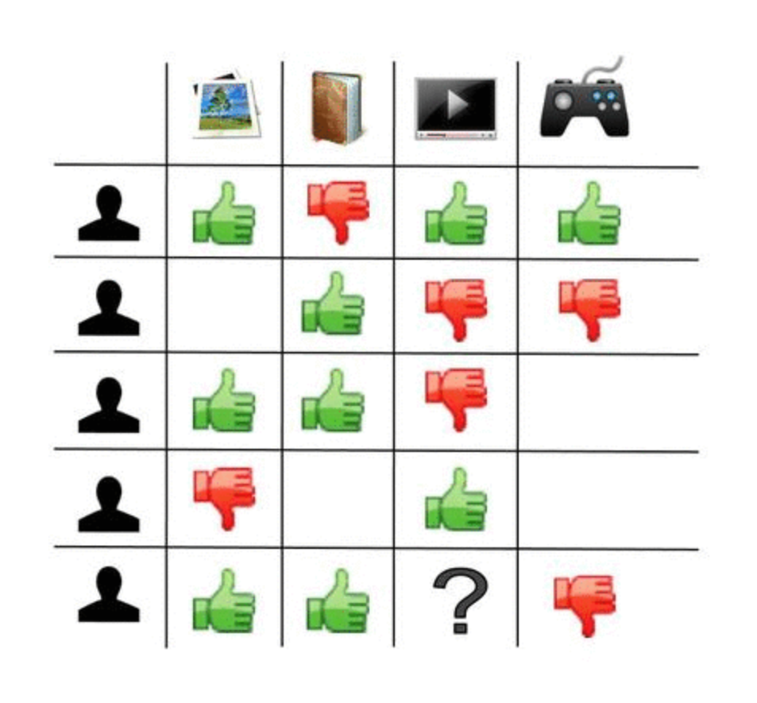
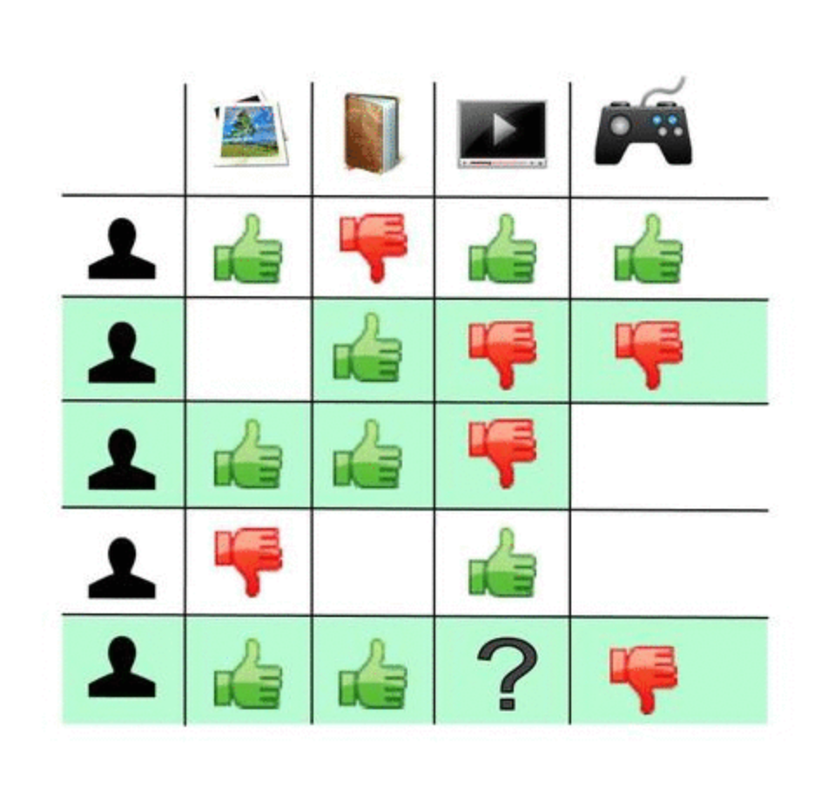
What is collaborative filtering
Collaborative Filtering (CF) is a widely used technique in recommender systems. It predicts a user’s potential interests by analyzing similarities among users or items—that is, through “collaboration.” Based on these similarity patterns, the system recommends content that similar users have liked or interacted with.
For example, the last user likes photos 👍, books 👍, and dislikes games 👎. Users 2 and 3 have similar tastes and both dislike videos 👎. So, the system predicts that the last user will also dislike videos 👎.

Slide 8
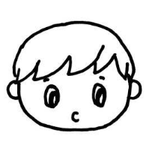

Type of CF
Collaborative filtering can be classified into two types based on approach:
User-based
Item-based
Identify users who have similar interests to the target user and recommend items that these similar users have liked.
Identify items that are similar to the target item and recommend them based on the target user’s interactions with these similar items.

Slide 9
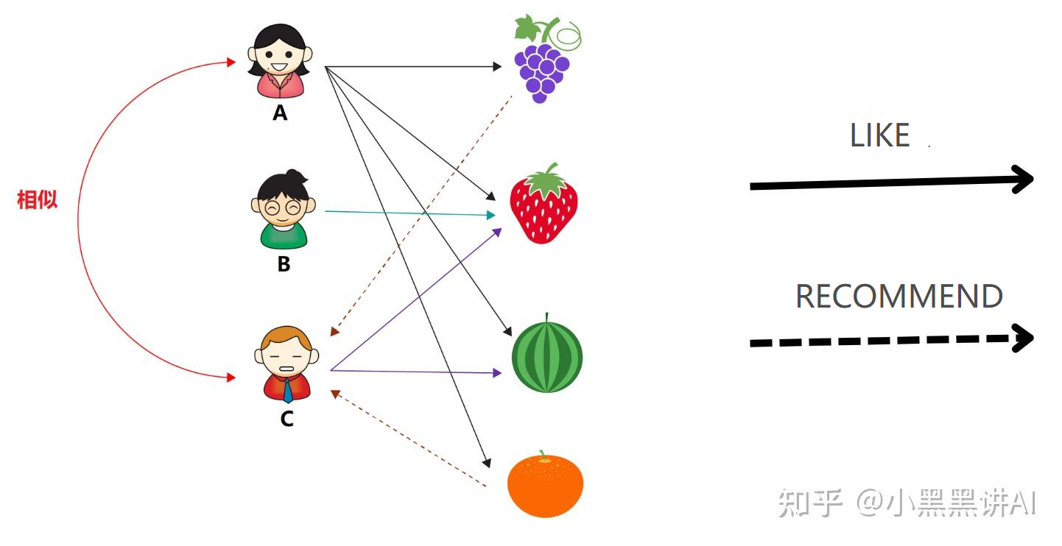
User-based CF
USER-BASED
Identify the “neighboring users” whose interests are most similar to the target user.
Predict the target user’s rating by computing a weighted average of the neighbors’ ratings.
“人以群分”
Find the similar user first -> find the recommendation
Notes:
You can see C like melon and strawberry, and so does A, so A is the neighbor of C, predict C will like orange as A.

Slide 10
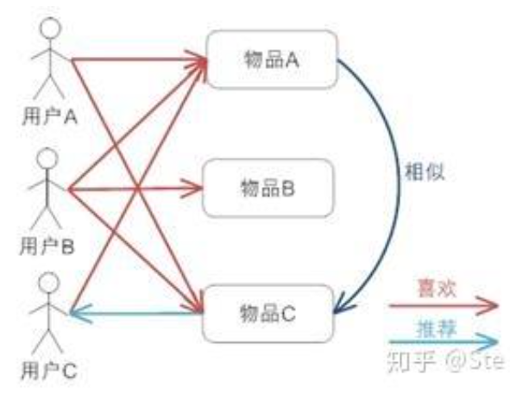
Item-based CF
ITEM-BASED
Identify items most similar to the target item.
Predict the user’s rating for the target item by using their ratings on these similar items.
“物以类聚”
Based on the ITEM , recommend to different people.
Notes:
用户A、C都喜欢物品A，而用户A还喜欢物品C，且物品C与物品A相似，故而就会给用户A推荐物品C。

Slide 11
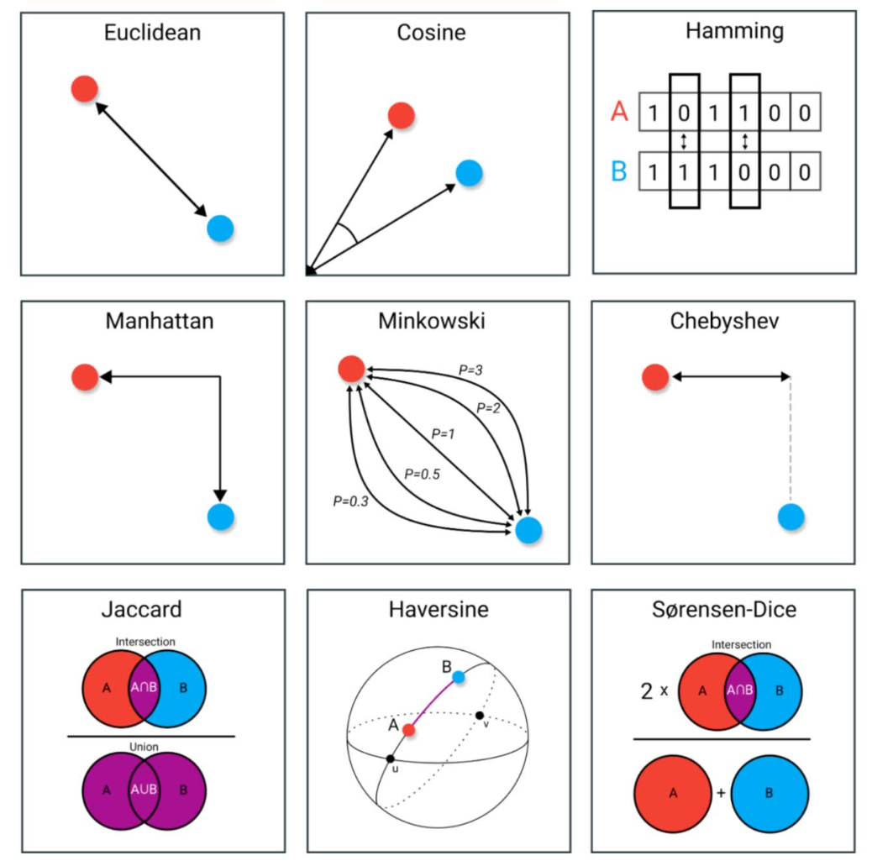
How to evaluate “similarity”?
We can use various mathematical models to represent the relationships between users and items, such as matrices or graphs. Subsequently, we can apply different methods to quantify the similarity between users or between items.
Multiple ways to describe similarity

Slide 12
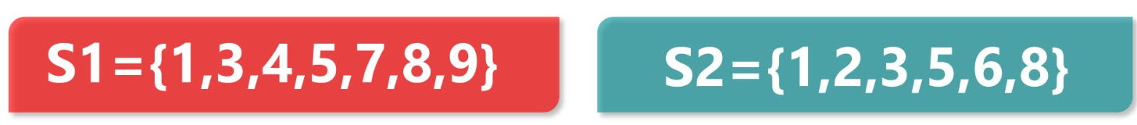
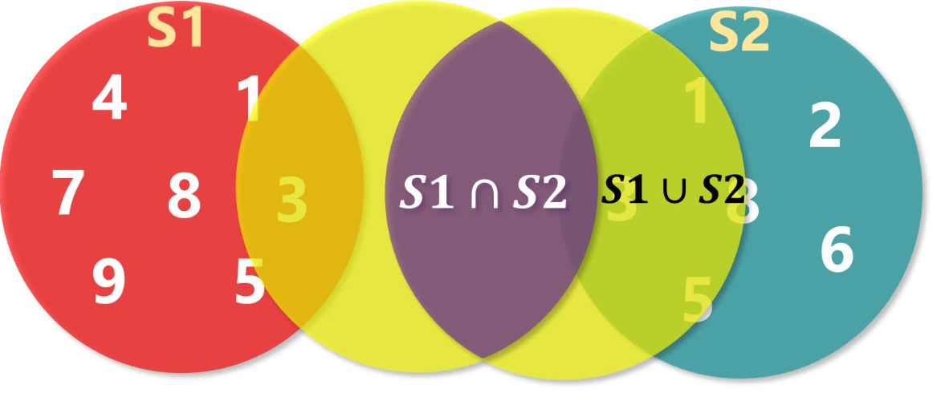
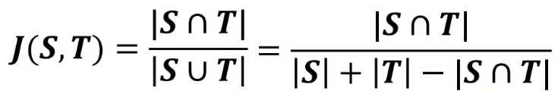
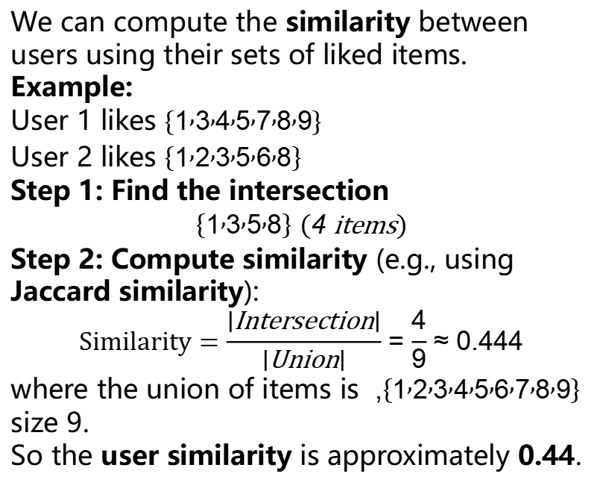
Method1: Jaccard Similarity
We can compute the similarity between users using their sets of liked items.
Example:
User 1 likes $\left\{1 , 3 , 4 , 5 , 7 , 8 , 9\right\}$
User 2 likes $\left\{1 , 2 , 3 , 5 , 6 , 8\right\}$
Step 1: Find the intersection
$$\left\{1 , 3 , 5 , 8\right\} \left(\text{4 }\text{items}\right)$$
Step 2: Compute similarity (e.g., using Jaccard similarity):
$$\text{Similarity}=\frac{∣\text{Intersection}∣}{∣\text{Union}∣}=\frac{4}{9}≈0.444$$
where the union of items is $\left\{1 , 2 , 3 , 4 , 5 , 6 , 7 , 8 , 9\right\}$, size 9.
So the user similarity is approximately 0.44.
Notes:
元素 element

Slide 13
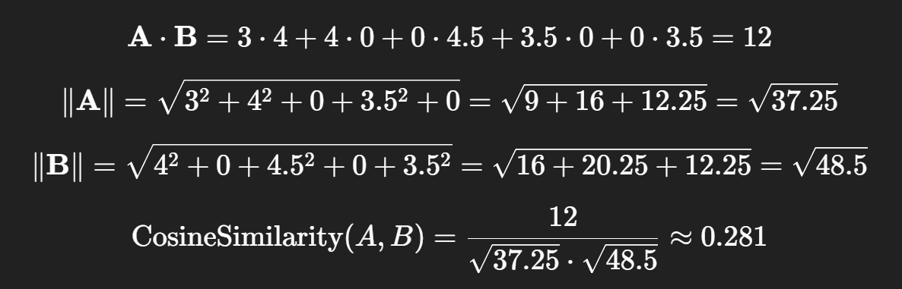
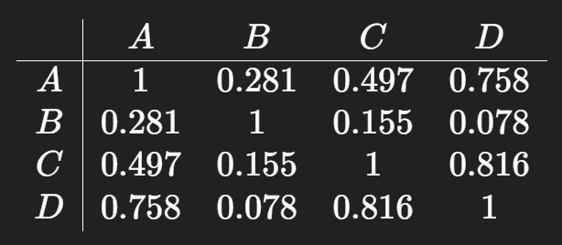

Method2: Cosine Distance
User\Item | 1 | 2 | 3 | 4 | 5
A | 3 | 4 | - | 3.5 | -
B | 4 | - | 4.5 | - | 3.5
C | - | 3.5 | - | - | 3
D | - | 4 | - | 3.5 | 3
Indicating how closely their interests align regardless of the absolute rating values.
$$\text{Cosine} \text{Similarity}=\cos\left(θ\right)=\frac{A⋅B}{|A| |B|}$$
focusing on the direction of preferences rather than the absolute rating values.
Notes:
Norm of A and B

Slide 14
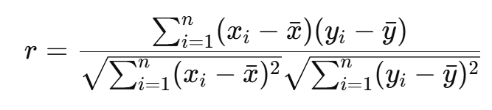
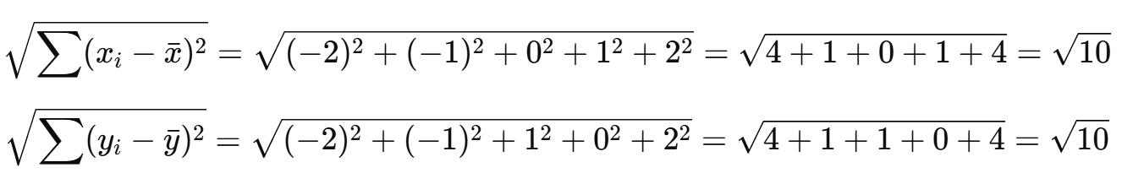
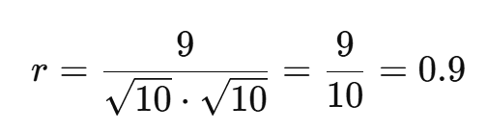
Method3: Pearson correlation coefficient
The Pearson correlation coefficient measures the strength and direction of the linear relationship between two variables. Its value ranges from −1 to 1:
( r = 1 ): Perfect positive correlation; the two variables have a completely linear positive relationship.
( r = -1 ): Perfect negative correlation; the two variables have a completely linear negative relationship.
( r = 0 ): No linear correlation (note: this does not mean there is no relationship at all, only that the linear relationship is zero).
Item | User_X | User_Y
1 | 1 | 2
2 | 2 | 3
3 | 3 | 5
4 | 4 | 4
5 | 5 | 6
A Pearson correlation of 0.9 between two users indicates they have very similar preferences, so one user’s liked items can effectively inform recommendations for the other.

Slide 15
Similarity method Contrast
Similarity method
Jaccurd
cosine
Pearson
Simple and intuitive
ignores rating differences
captures rating direction but not bias
rating bias
linear correlation
misses non-linear

Slide 16



Example: use user/item based CF
Suppose we have 4 users and 5 movies, and their rating matrix is as follows (ratings range from 1 to 5, with 0 indicating that the movie has not been watched):
 | Movie A | Movie B | Movie C | Movie D | Movie E
User 1 | 5 | 3 | 0 | 1 | 0
User 2 | 4 | 1 | 2 | 1 | 0
User 3 | 1 | 1 | 0 | 5 | 4
User 4 | 0 | 0 | 5 | 4 | 5
Goal: Recommend movies to User 1 that they have not yet watched but are likely to enjoy.

Slide 17
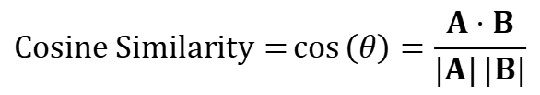
User-based CF
 | Movie A | Movie B | Movie C | Movie D | Movie E
User 1 | 5 | 3 | 0 | 1 | 0
User 2 | 4 | 1 | 2 | 1 | 0
User 3 | 1 | 1 | 0 | 5 | 4
User 4 | 0 | 0 | 5 | 4 | 5
1. Calculate the cosine similarity between users.
$$\text{Cosine} \text{Similarity}=\cos\left(θ\right)=\frac{A⋅B}{|A| |B|}$$
Pairs | Similarity
1-2 | 0.865
1-3 | 0.335
1-4 | 0.183
So we can choose the movie C (user 2 liked) to recommend user 1 to watch!
User 2 is most similar !

Slide 18
Item-based CF
Calculate the cosine similarity between movies.
2. Because user1 haven’t watch movie c and e, we choose them to calculate.
Target Movie | Seen Movie | Similarity | User1 Rating r(Seen) | Similarity × Rating
Movie C | Movie A | 0.229 | 5 | 1.145
 | Movie B | 0.375 | 3 | 1.125
 | Movie D | 0.623 | 1 | 0.623
Sum |  |  |  | 2.893
Target Movie | Seen Movie | Similarity | User1 Rating r(Seen) | Similarity × Rating
Movie E | Movie A | 0.154 | 5 | 0.770
 | Movie B | 0.289 | 3 | 0.867
 | Movie D | 0.763 | 1 | 0.763
Sum |  |  |  | 2.400
Similarity × Rating → Weighted Contribution Sum → Total Weighted Influence
Recommend C!
Notes:
之前的喜欢与不喜欢相对简单，直接判断，现在的需要用rating score 来衡量

Slide 19
3
CF workflow

Slide 20


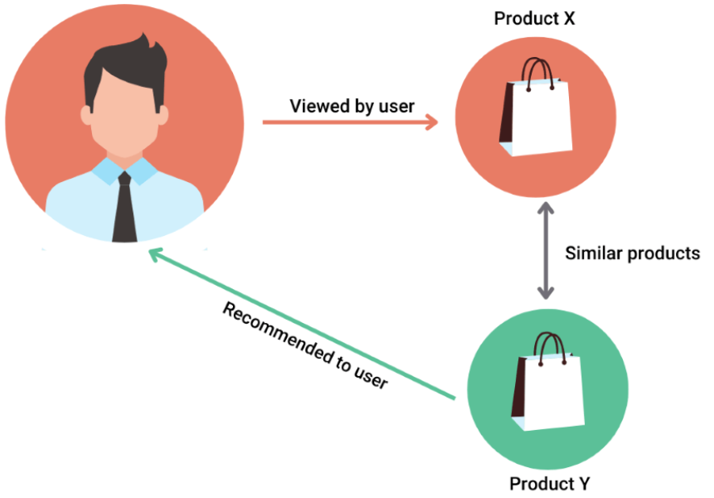
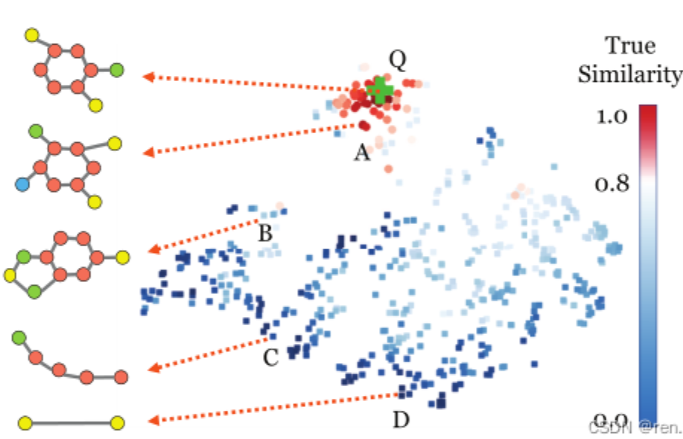

Workflow
Compute similarities between users or items
Estimate user preferences for unseen items.
Similarity Computation
Prediction
Data Collection
Model Training
Recommendation Output
Gather user–item interactions (e.g., ratings, clicks, purchases).
train a predictive model.
Generate a ranked list of recommended items for each user.

Slide 21
4
Challenge and solution

Slide 22
Pros
1
2
Does not rely on item content
Recommend
non-obvious items
3
4
5
Mature, efficient, and effective.
personalization
privacy

Slide 23
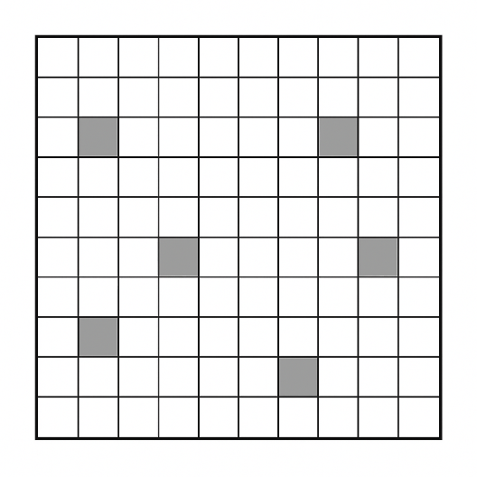

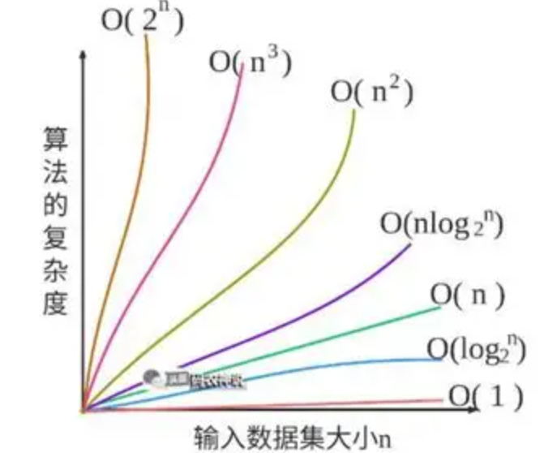

Challenge
I10 i9 i8 i7 i6 i5 i4 i3 i2 i1
buy
u1 u2 u3 u4 u5 u6 u7 u8 u9 u10
Sparsity
Cold-start
Scalability
Suppose on Taobao there are billions of users and billions of items. A typical user (e.g., User1) may purchase only about 10 items — far fewer than the total number of available products. Similarly, an item (e.g., Item1) may be purchased by only around 100 users. As a result, the user–item interaction matrix becomes extremely sparse, since most users have interacted with only a tiny fraction of all items.
When new users sign up for a website, we know very little about them. Since there isn’t enough data to calculate similarities with other users, the data becomes sparse, making it difficult to generate accurate recommendations.
The computational cost increases with the number of users and items, since we need to calculate similarities between every pair of users or items, which makes the process very expensive.
Notes:
稀疏性 用一个实例来讲解 真实的矩阵
Cold-start 缺少用户
paris

Slide 24
How to deal with Sparsity?
New model: Latent Factor Model, LFM
Traditional question | LFM pros
Sparsity | No longer rely on direct similarity between users or items.
Similarity is hard to calculate | Learn indirect associations through a latent feature space.
Generalization | Can predict user preferences for unseen item, based on latent features.
1. Goal: To uncover hidden features that explain why certain ratings or preferences occur. 2. Method: Dimensionality Reduction via Matrix Factorization Collaborative filtering heavily relies on historical data, which is often sparse in real-world systems. Therefore, matrix factorization is used to reduce dimensionality, producing latent representations of users and items that reflect their underlying characteristics.
Notes:
用户–物品矩阵非常稀疏（大多数用户只评价过极少项目）；
相似度难以计算（例如两个用户共同评分的项目太少）；
很难进行泛化（冷启动、长尾物品无法推荐）。
隐语义模型的优势：
不再依赖用户之间或物品之间的“直接相似度”；
通过潜在空间学习到“间接关联”；
即使用户没看过某类电影，也能根据潜在特征预测他是否会喜欢。

Slide 25
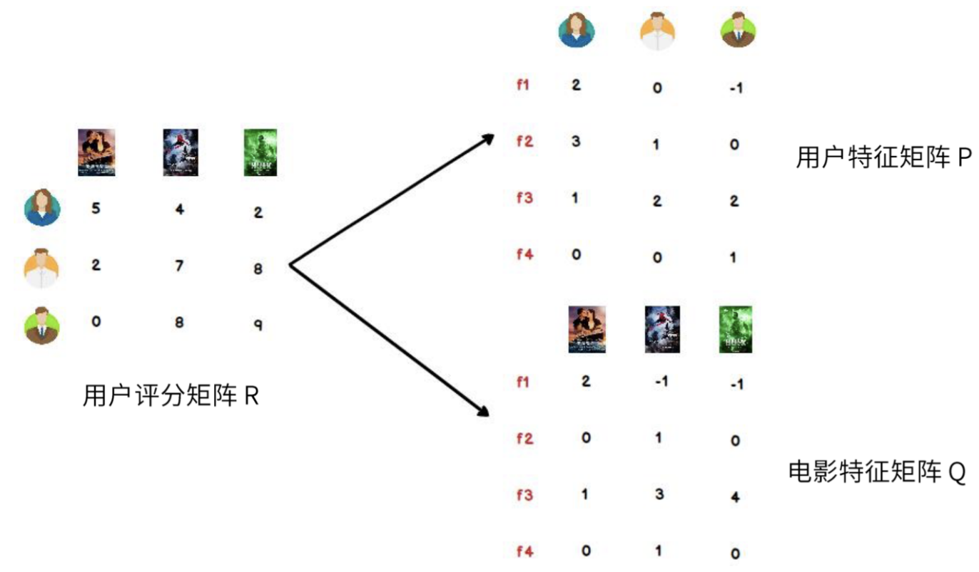
Matrix Factorization, MF
The first step is to understand how to factorize the user–item rating matrix into two latent feature matrices.
Thus, it is crucial to learn classical matrix factorization methods, as they form the foundation of latent factor models in recommender systems.
Classical method:
Eigen Decomposition
2. Singular Value Decomposition (SVD)

Slide 26
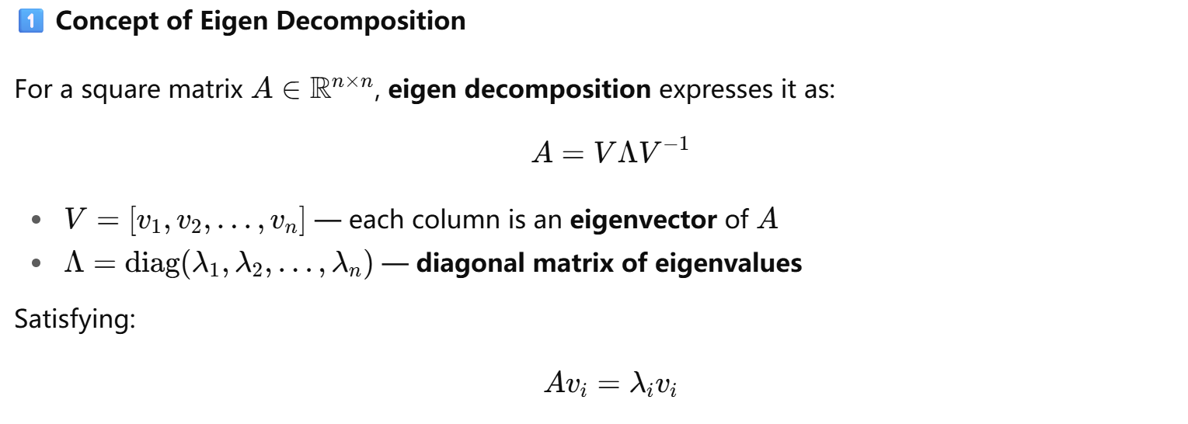
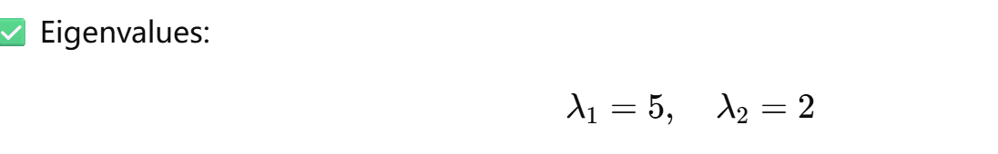
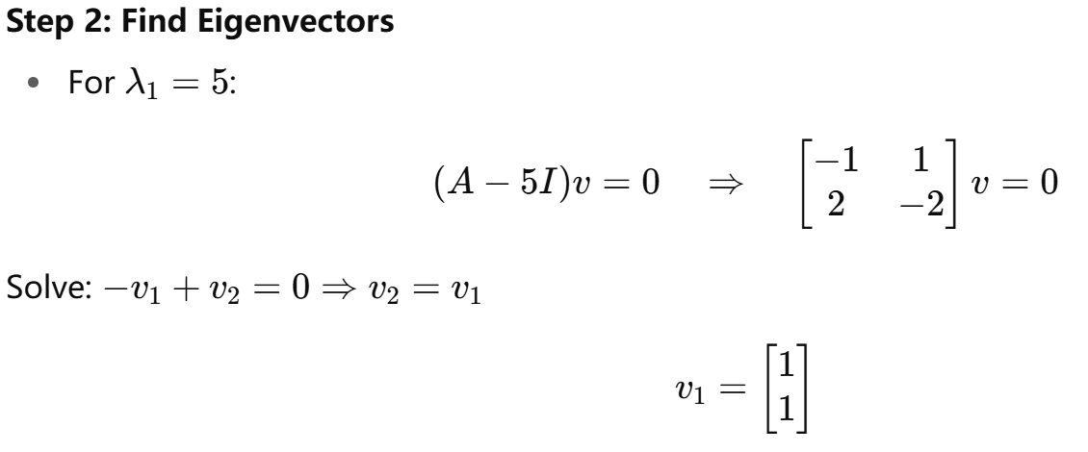
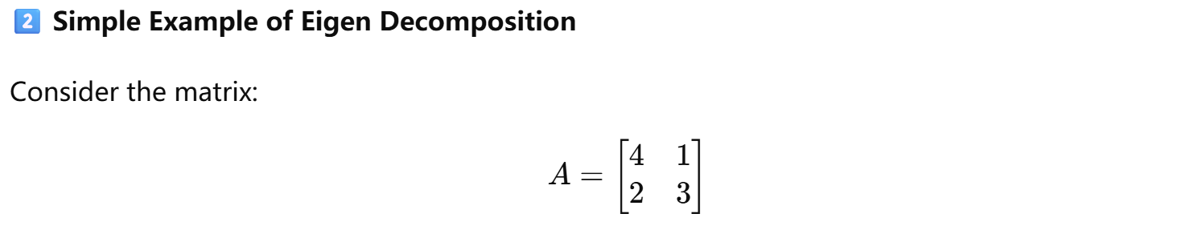
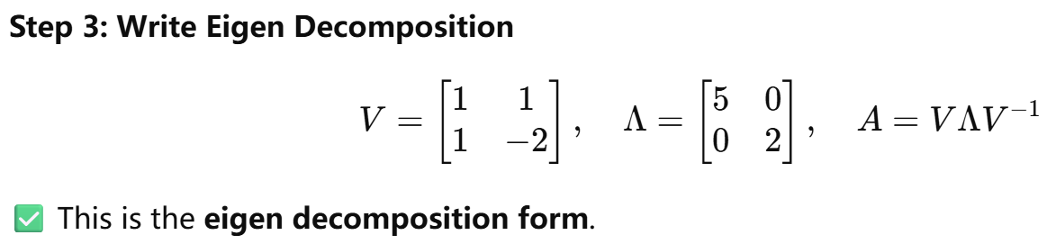
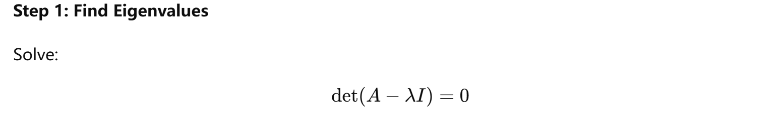
Eigen Decomposition

Slide 27
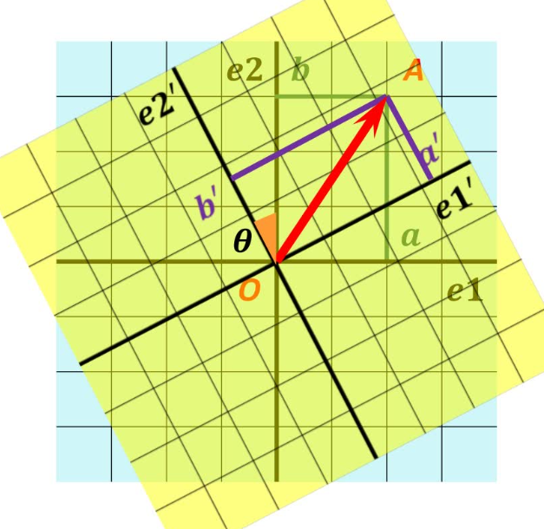
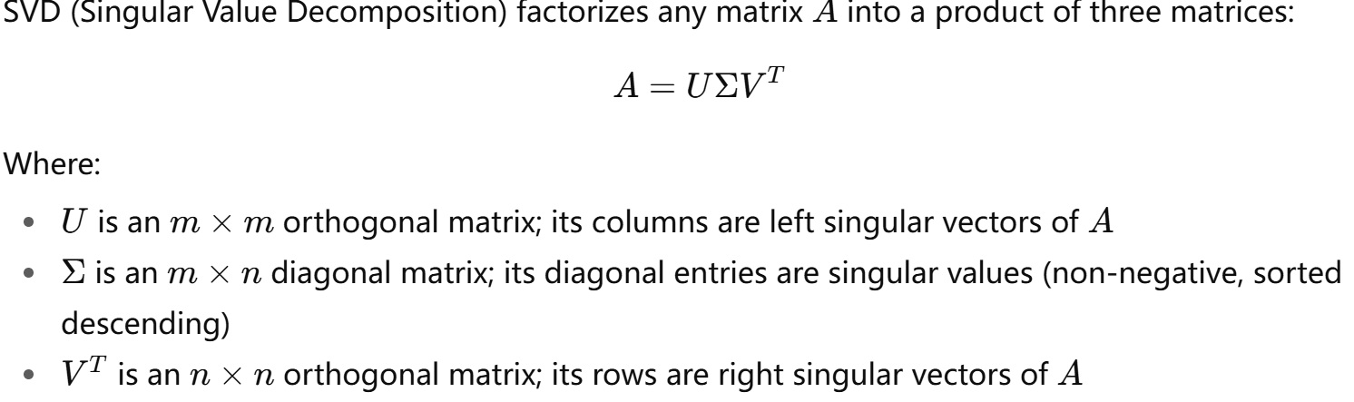
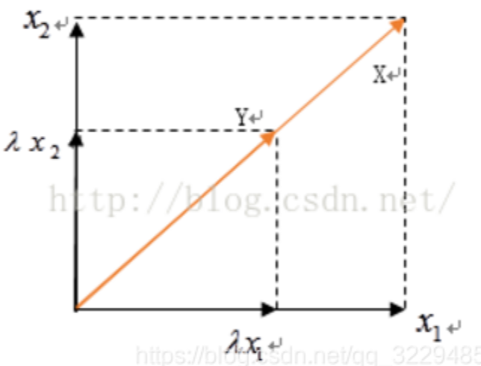
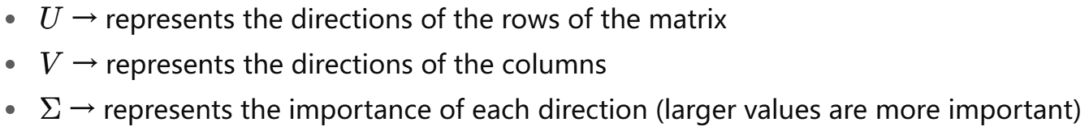
Singular Value Decomposition (SVD)
But not all matrix is n*n…
Here we introduce more general way : SVD
Rotational
length
Notes:
UV 是旋转变换 ∑是伸缩变换

Slide 28
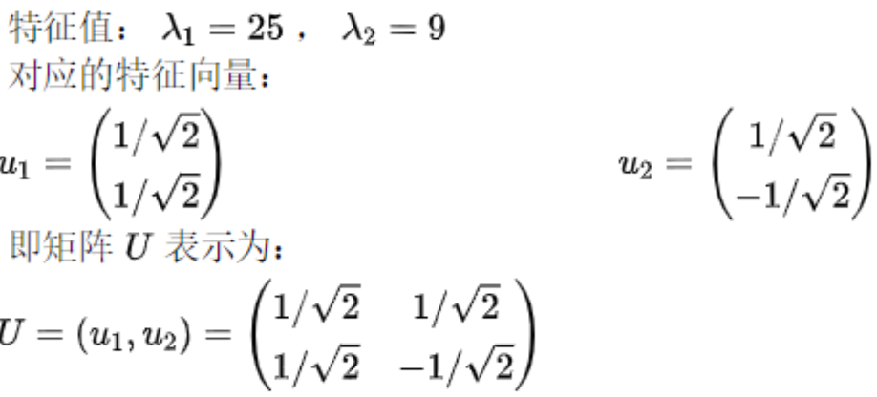
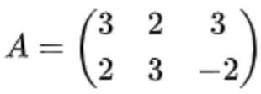
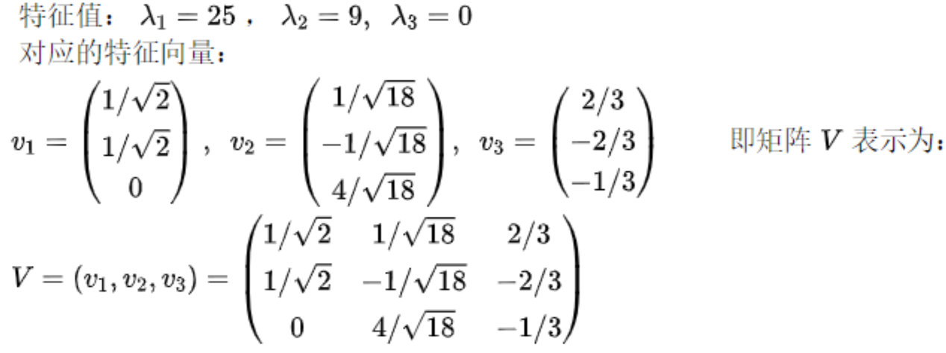
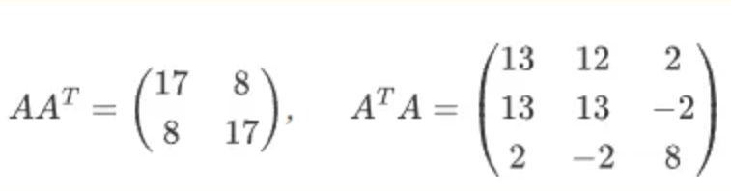
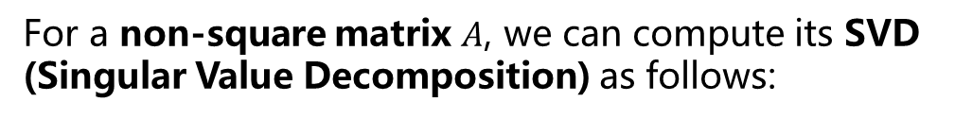
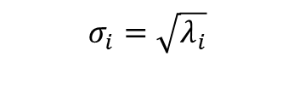
Singular Value Decomposition (SVD)
How to calculate?
For a non-square matrix $A$, we can compute its SVD (Singular Value Decomposition) as follows:
Step 1: Compute $A^{T}A$and $AA^{T}$
Step 3: Compute singular values
Step 2: Solve for eigenvalues and eigenvectors
$$σ_{i}=\sqrt{λ_{i}}$$
Notes:
转置 transpose
The sqrt of …

Slide 29
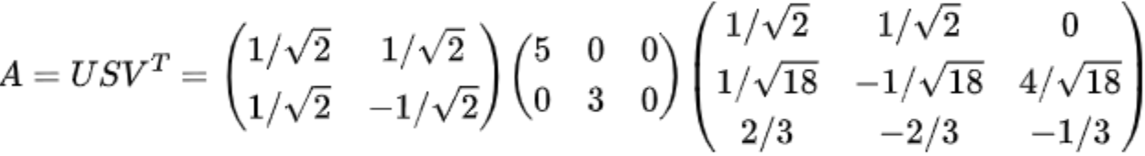
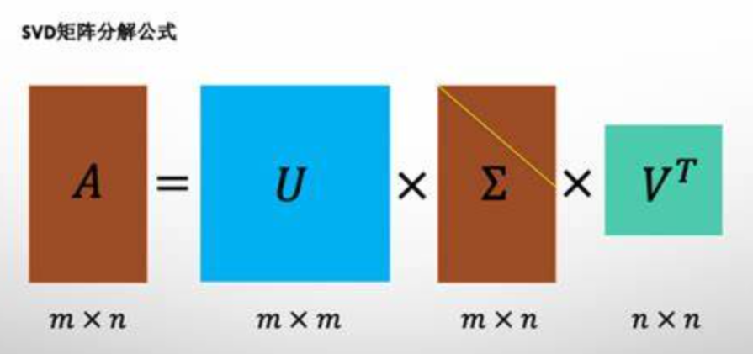
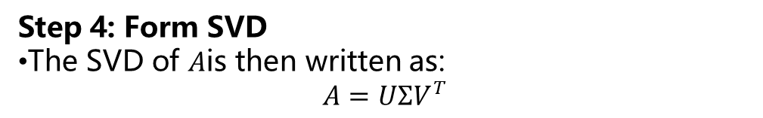
Singular Value Decomposition (SVD)
Step 4: Form SVD
The SVD of $A$is then written as:
$$A=UΣV^{T}$$
Notes:
转置 transpose

Slide 30
Example
Suppose we have 3 users (U1, U2, U3) and 4 movies (M1–M4), with the following rating matrix (scores range from 1 to 5):
Goal: 👉 Predict U1’s rating for M3 — the missing value — using collaborative filtering (e.g., user-based, item-based, or matrix factorization).
 | M1 | M2 | M3 | M4
U1 | 5 | 3 | ? | 1
U2 | 4 | ? | 2 | 1
U3 | 1 | 1 | ? | 5
🧩 Step 1: Assume the latent factor dimension is 2
We assume that a user’s movie preferences are mainly determined by two hidden features:
Feature 1: Action
Feature 2: Romance
Therefore, we represent both users and movies as two-dimensional vectors in this latent space.

Slide 31

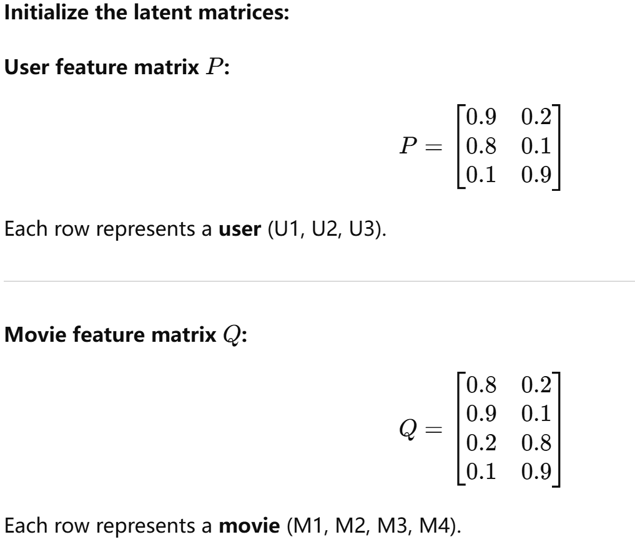
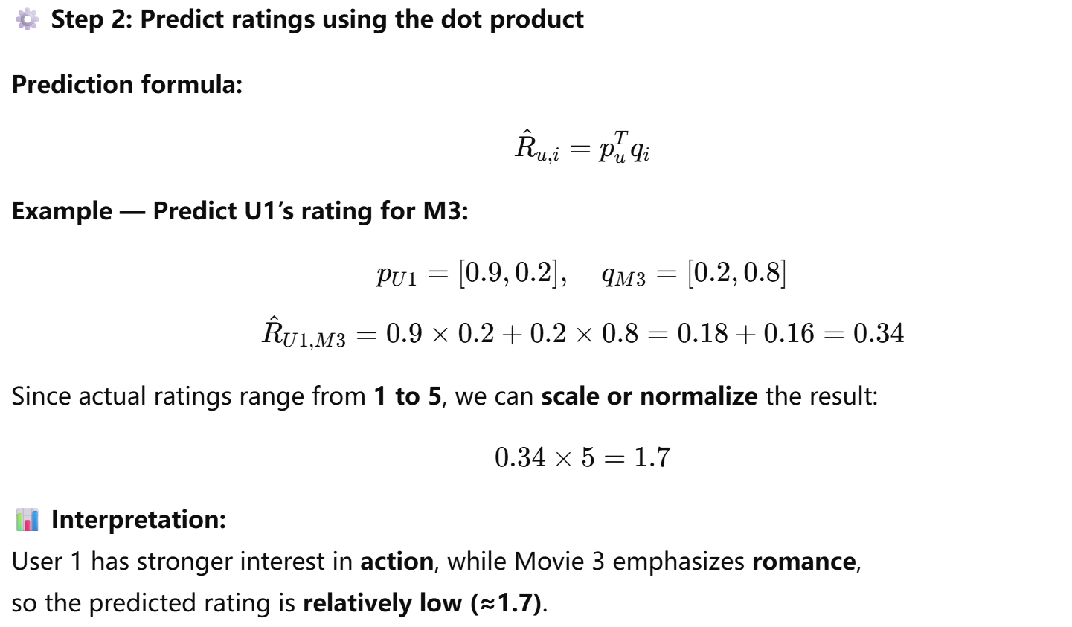
Example
Notes:
矩阵分解中的 $P$（用户特征矩阵）和 $Q$（物品特征矩阵）中的数值，是连续实数参数，不是“比例”或“权重和为1”的概率。
就是把用户对item的评分矩阵分解为两个目标特征的矩阵。

Slide 32
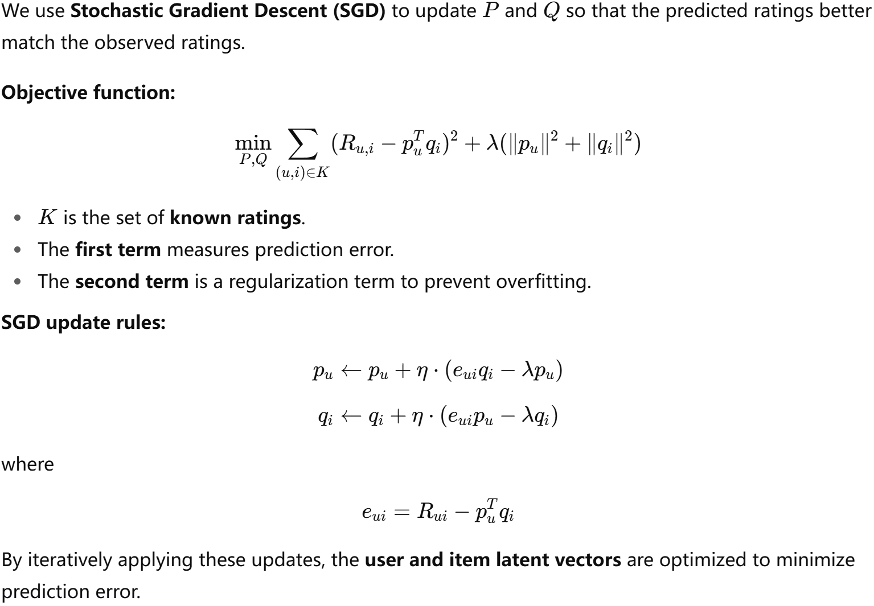
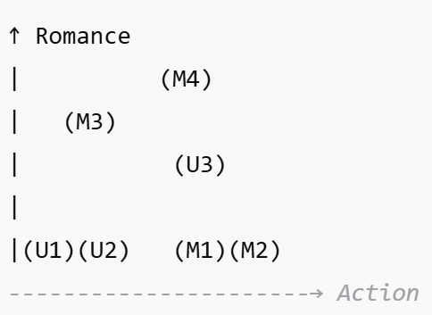
LFM-SGD
Final result:
Prediction Error Regularization
We found the hidden feature, “romance” and “action”.
Notes:
但是第二步中的计算结果不一定是最好的，我们会利用梯度下降法来更新P和Q矩阵，来得到更加精确的结果。
正则化防止过拟合 1️⃣ 矩阵和向量
符号含义备注$R$用户-物品评分矩阵每个元素 $R_{ui}$表示用户 $u$对物品 $i$的评分$R_{ui}$用户 $u$对物品 $i$的真实评分已知评分，训练目标是预测未知评分${\hat{R}}_{ui}$ 或 $p_{u}^{T}q_{i}$用户 $u$对物品 $i$的预测评分点积表示用户向量和物品向量的相似性$P$用户特征矩阵每一行 $p_{u}$是用户 $u$的潜在特征向量（长度为隐向量维度 k）$p_{u}$用户 $u$的潜在特征向量维度为 $k$，表示用户的兴趣特征$Q$物品特征矩阵每一行 $q_{i}$是物品 $i$的潜在特征向量$q_{i}$物品 $i$的潜在特征向量维度为 $k$，表示物品的属性特征
2️⃣ 集合与指标
符号含义$K$已知评分的集合$u$用户索引$i$物品索引
3️⃣ 损失函数相关
符号含义备注$\left(R_{ui}−p_{u}^{T}q_{i}{\left.)\right.}^{2}\right.$预测误差平方惩罚预测和真实评分的差距$λ$正则化系数控制参数大小，防止过拟合$∥p_{u}∥^{2}$用户向量的平方范数正则化用户特征$∥q_{i}∥^{2}$物品向量的平方范数正则化物品特征
4️⃣ SGD 更新公式
符号含义$e_{ui}$预测误差，等于 $R_{ui}−p_{u}^{T}q_{i}η$学习率$p_{u}←p_{u}+η\left(e_{ui}q_{i}−λp_{u}\right)$更新用户向量$q_{i}←q_{i}+η\left(e_{ui}p_{u}−λq_{i}\right)$更新物品向量
💡 直观理解：
$p_{u}^{T}q_{i}$→ 用户和物品在潜在空间的“匹配度”
$e_{ui}$→ 当前预测和真实评分的差距
$ηe_{ui}q_{i}$→ 根据误差调整用户特征
$−ηλp_{u}$→ 正则化收缩，防止特征过大

Slide 33
Cold-start, Scalability?
Cold-start
Scalability
Use social networks, reviews, or browsing logs to infer preferences.
Ask users to rate or choose preferred items during sign-up.
Use distributed frameworks (e.g., Hadoop, Spark, GPU) for parallel similarity computation and model training.
LLM?!
Notes:
在处理这些非结构化数据时LLM有较好的能力，由此引出LLM-REC

Slide 34
5
Arise of LLM

Slide 35
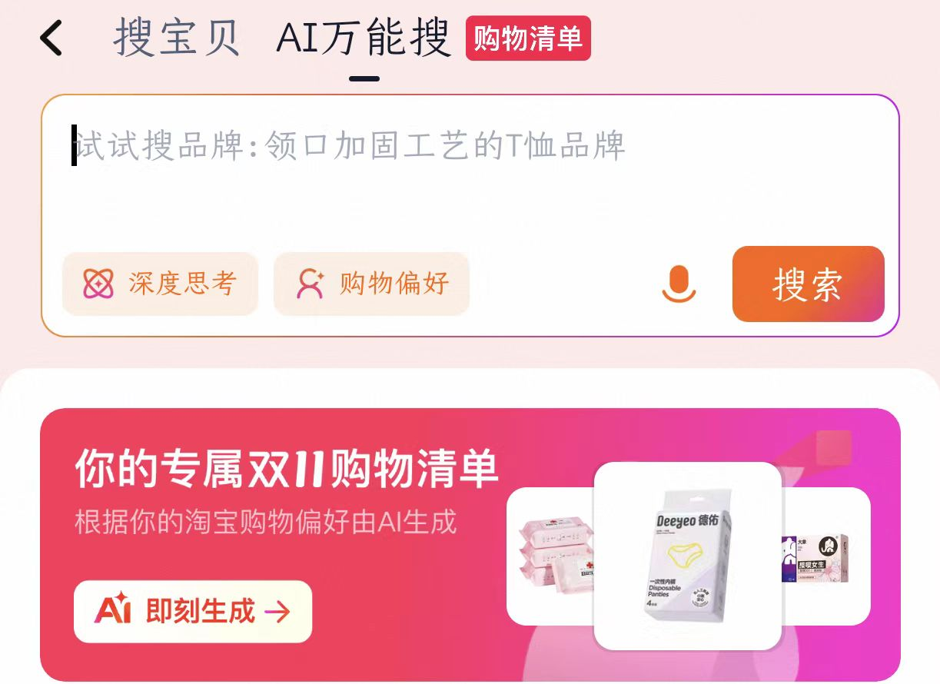
Arise of LLM
understanding
generating RS
reasoning with text
LLM
Previous: search “Naruto” in website.
With the help of LLM…
Now: “I want to see Hot-blooded anime!”
Recent studies integrate LLMs as either the core or an auxiliary component of recommender systems — a direction known as LLM4Rec.
Deepseek-enhanced Taobao recommendation system

Slide 36
6
LLM4Rec
Notes:
重点

Slide 37
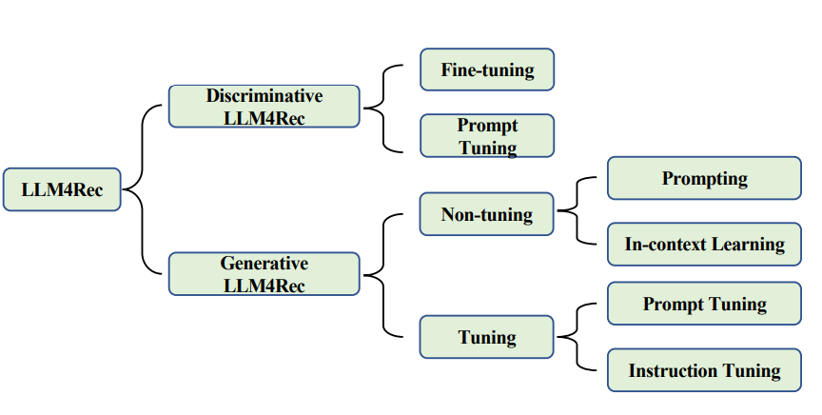
Modes
Discriminative Models: Focus on distinguishing and understanding. They analyze given data to classify it into predefined categories or produce meaningful numerical representations. In recommendation systems, they are used to judge whether a user–item pair is a good match or to learn embeddings for users and items.
Generative Models: Focus on creating and generating. They generate coherent new text or data based on context. In recommendation systems, they can directly generate item names or IDs to recommend, or produce explanations and descriptions for recommendations.
It acts like a “referee” — given a user and an item, it judges whether they are a good match.
It works like a“smart friend” — directly telling you what you might want to watch and why it’s recommended.

Slide 38
Modes
Pop quiz!
Suppose a system analyzes a user’s watching history and directly generates a list of recommended movies with natural-language reasons like “You may like Titanic because you enjoyed The Notebook.” This system is most likely using a:
A. Discriminative model B. Generative model C. Linear regression model D. Clustering algorithm
✅ Answer: B Explanation: A generative model creates new outputs (e.g., movie names, explanations, summaries). In contrast, discriminative models would only score existing candidate movies but wouldn’t generate natural-language recommendations.

Slide 39
Training manners
In LLM4Rec, the training mainly focuses on how to leverage user, item, and interaction data to teach the LLM to make recommendations.
The training approach directly affects the model’s performance, generalization ability, and computational cost.

Slide 40
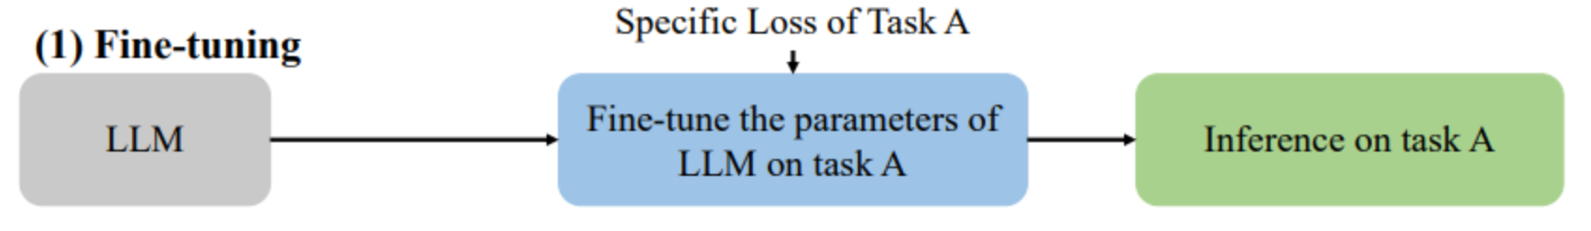
Manner1: Fine-tuning
Fine-tuning refers to taking a pre-trained large language model (e.g., GPT, BERT, LLaMA) and further training it on task-specific data so that it better adapts to the requirements of the target task.
a task-specific loss function to guide fine-tuning.
Small data → LoRA
Large data → SFT / RLHF
Process：
Prepare Data → Convert Data to Model Input → Choose Fine-tuning Method → Train & Validate → Deploy & Continuous Optimization
Notes:
Classification → Cross-Entropy Loss
Regression → Mean Squared Error (MSE) Loss
Recommendation/Ranking → BPR Loss or Contrastive Loss

Slide 41
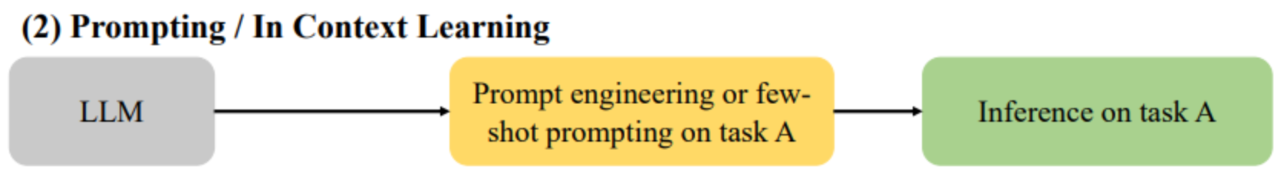
Manner2: Prompting / In-Context Learning
Uses a pre-trained LLM to perform tasks without changing its parameters, by designing prompts or providing a few examples.
Few-shot Prompting: Provide a small number of examples in the prompt so the model can infer the task pattern.
In-Context Learning: The model understands the task from the context in the prompt, requiring no gradient updates.
Prompt Engineering: Carefully craft questions or instructions to guide the model’s output.
giving a chef a detailed recipe
teaching a child with math
doing a live demonstration
Notes:
Simulate your behavior.

Slide 42



Manner3: Prompt Tuning
Prompt Tuning is a parameter-efficient fine-tuning (PEFT) method:
Instead of fully fine-tuning the entire LLM, it only tunes the input prompt (or a small subset of model parameters).
Hard prompt: Fixed natural language text
Soft prompt: Trainable vector embeddings (not human-readable text)
Hard prompt example
Soft prompt example

Slide 43

Manner4: Instruction Tuning
Instruction Tuning refers to fine-tuning an LLM using natural language instructions, enabling the model to perform tasks based on task descriptions, rather than relying solely on task-specific data.
Aspect | Instruction Tuning
Similar to Prompting/ICL | Uses instructions to guide the model.
Similar to Fine-tuning | Updates LLM parameters via gradients to improve performance.
Similar to Prompt Tuning | Can leverage PEFT, but focuses more on generalizing across multiple tasks.

Slide 44
Manner quiz
Pop quiz!
You are given a pre-trained LLM and want to adapt it to a new task with very few examples, without updating the model parameters. Which method is the most suitable?
A. Fine-tuning B. Prompting / In-Context Learning C. Prompt Tuning D. Instruction Tuning.
Answer: B
Explanation:
Fine-tuning (A) requires full model updates, unsuitable for few-shot.
Prompting / ICL (B) fits perfectly: only design prompts/examples, model remains frozen.
Prompt Tuning (C) requires gradient updates on prompt embeddings.
Instruction Tuning (D) requires multi-task fine-tuning with parameter updates.

Slide 45

Main paradigms
In recommender systems, LLMs can be applied in three main paradigms:
Different tokens
(using different color)
Eg. User-token, item-token
Input sequence: text sequence.
Semi / un structured data
Embedding vectors, value-based
The input of large language models usually includes token and positional embeddings, while the output module generates the desired embeddings or tokens.
1. Input: User profiles and item descriptions are fed into the LLM.
2. Embedding Generation: The LLM encodes these texts into semantic embeddings, capturing deep user and item features.
3. Recommendation: The recommender system uses these embeddings to compute similarity, predict preferences, and generate the final recommendations.
Notes:
嵌入向量（Embedding Vectors）的工作原理基于将复杂的数据类型，如文本中的单词或句子、图像、用户行为等，转换为数值向量形式。

Slide 46
Main paradigms
In recommender systems, LLMs can be applied in three main paradigms:
Different tokens
(using different color)
Eg. User-token, item-token
Input sequence: text sequence.
Semi / un structured data
Discrete tokens or labels (used as the input of RS)
Input: User and item information are provided to the LLM.
Semantic Tag Generation: The LLM interprets this information and generates semantic tags (e.g., “The user dislikes thriller movies”).
Decision Support: These tags are then used to enhance recommendation decisions, improving interpretability and personalization.
Notes:
Token 词元

Slide 47
Main paradigms
In recommender systems, LLMs can be applied in three main paradigms:
Generate response directly
Different tokens
(using different color)
Eg. User-token, item-token
Natural language sequence
A complete prompt sequence—comprising the user profile, behavioral history, candidate items, and a task instruction—is fed to the LLM. The LLM then directly outputs the recommendation list, implementing an end-to-end recommendation pipeline where the model maps raw inputs to final recommendations without intermediate embedding or ranking modules.
Notes:
从输入（用户数据）到输出（推荐结果），模型在中间不需要额外的模块或人工干预，直接通过一次性推理（inference）完成整个任务。

Slide 48
8
LLM VS CF
Notes:
这里介绍那堆公式的部分

Slide 49
How LLM optimize the CF?
Question 1: Data Sparsity and Cold Start
Problem in Traditional Collaborative Filtering:
Its core lies in “collaboration,” relying on the pattern of “users with similar preferences also like…”. When new users (with no history), new items (with no interactions), or niche users appear, the collaborative relationships cannot be established — causing the entire system to fail.
VS
Solution
Paradigm 1: LLM Embeddings + RS
Use the LLM as a general semantic encoder to convert textual information such as item titles, descriptions, and categories into high-quality semantic embeddings.

Slide 50
How LLM optimize the CF?
Question 2: Lack of Interpretability
Paradigm 2: LLM Tokens + RS
Solution: Use the LLM as a user preference analyzer. Given a user’s history, it generates a short summary like:
“The user is interested in psychology and self-help books.” This text provides a clear and interpretable signal — usable by the recommendation model or shown directly to the user as the reason for the recommendation.
VS
Essentially, it functions as a “black box.” The recommendation rationale is often simply “because users similar to you liked…,” which is vague and fails to reflect the user’s personalized interests.

Slide 51
How LLM optimize the CF?
Question 2: Lack of Interpretability
VS
Paradigm 3: LLM as RS
Solution: Use the LLM’s strong natural language generation ability to directly produce recommendations along with personalized explanations.
How it helps: By carefully designing prompts that ask the LLM to “recommend and explain,” the model can generate accurate explanations based on its understanding of the user’s history and item content.
Essentially, it functions as a “black box.” The recommendation rationale is often simply “because users similar to you liked…,” which is vague and fails to reflect the user’s personalized interests.

Slide 52
LLM VS CF
Dimension | Traditional CF | LLM Enhanced Recommendation
Data Source | Interaction Matrix (Rating/Click) | Interaction + Text Description + User Language Input
Cold start capability | Weak | Strong
Real-time/Scalability | Mature, well-optimized | Challenges Remain (Delay/Cost)
Semantic Understanding/Interpretability | Weak | Strong (can generate explanations, natural language)
Recommendation Diversity | Based on historical interactions, it may tend to become popular | More rich items can be expanded based on semantics/context
Cost/Engineering Complexity | Lower | Higher
Optimal Scenario | Sufficient data, dense interaction | New users/new projects, natural language preferences, complex user descriptions

Slide 53
9
New Trend

Slide 54

Trend
Here we recommend some cutting-edge papers for your reference.
1.A Survey on LLM-powered Agents for Recommender Systems
[2502.10050] A Survey on LLM-powered Agents for Recommender Systems
2. Large Language Model Enhanced Recommender Systems: A Survey
[2412.13432] Large Language Model Enhanced Recommender Systems: A Survey
Notes:
在这里介绍矩阵分解的相关内容

Slide 55
THANKS

